Slide 1
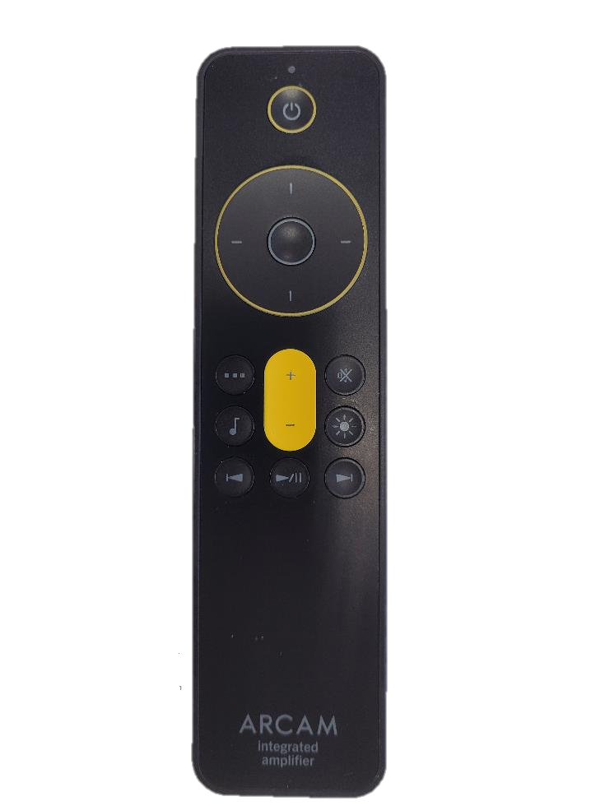
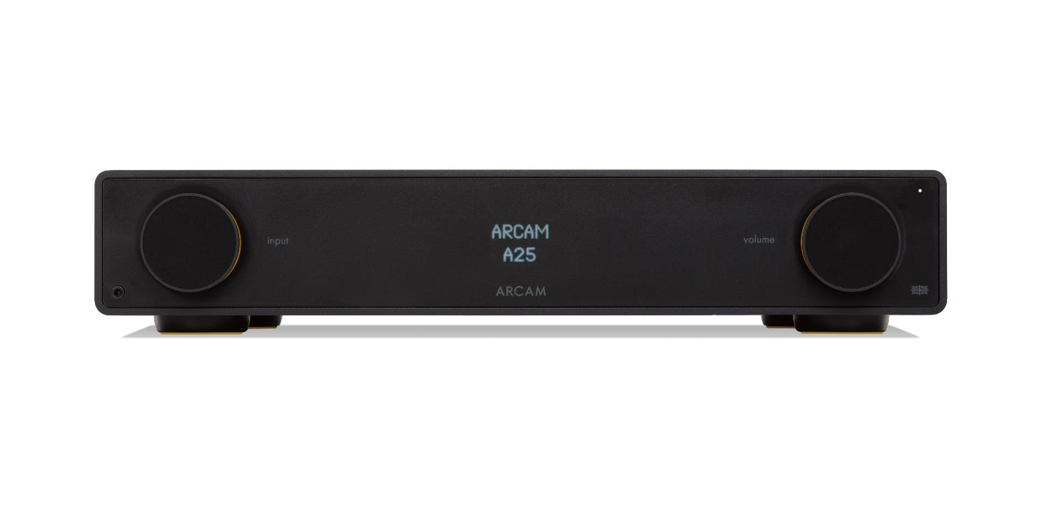
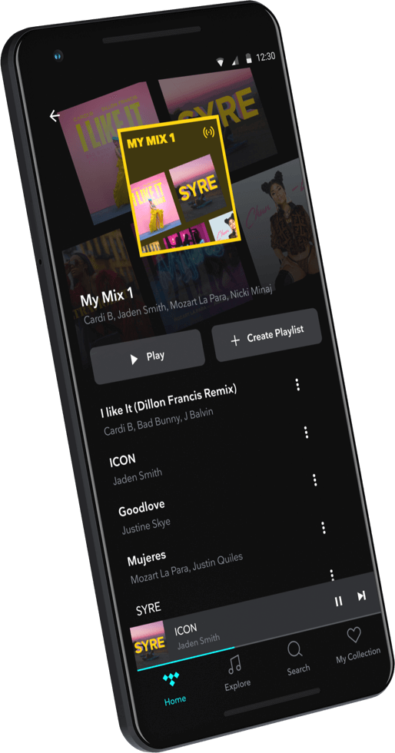
How to automatically switch to Bluetooth devices on the ARCAM RADIA amplifiers
Press the SETTINGS MENU button on the remote control
The display will show SYSTEM SETTINGS
Press the CURSOR button to scroll down to BT SETTINGS MENU.
Use the cursor button to scroll down to the BLUETOOTH INPUT AUTOSWITCH option
Press the SELECT button to confirm
Use the cursor to toggle between BT AUTOSWITCH ON / BT AUTOSWITCH OFF
If Autoswitch is set to on , the amplifier will automatically change input to BT when the connected Bluetooth device is played
SYSTEM SETTINGS
BT SETTINGS MENU
BLUETOOTH AUTOSWITCH
BT AUTOSWITCH ON
BT AUTOSWITCH OFF
BLUETOOTH
APTX
30

