Slide 1
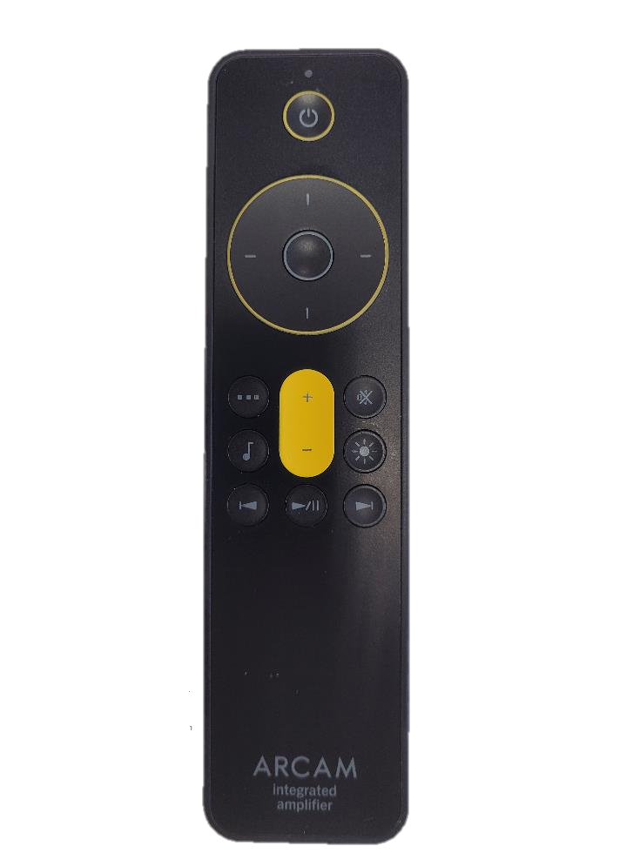
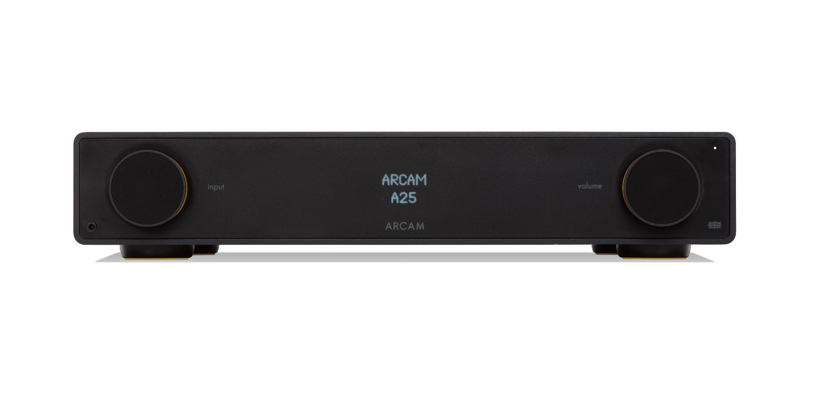
How to connect Bluetooth headphones to your Arcam Radia Amplifier
Make sure that the Bluetooth device is in discovery mode.
Press the music menu button to access the AUDIO OUTPUT menu
Press the SELECT button in the middle of the cursor to confirm
Scroll down to the PAIR BT OUTPUT option and press select button
Display will show LOADING..
After a short while a list of Bluetooth devices will be available
Use the scroll down button to select the relevant device
Press the SELECT button in the middle of the cursor
The display will show LOADING.. Followed by SUCCESS when connected
JBL TOUR
SUCCESS
ML 5909
LOADING..
LOADING
AUDIO OUTPUT
PAIR BT OUTPUT

