Slide 1
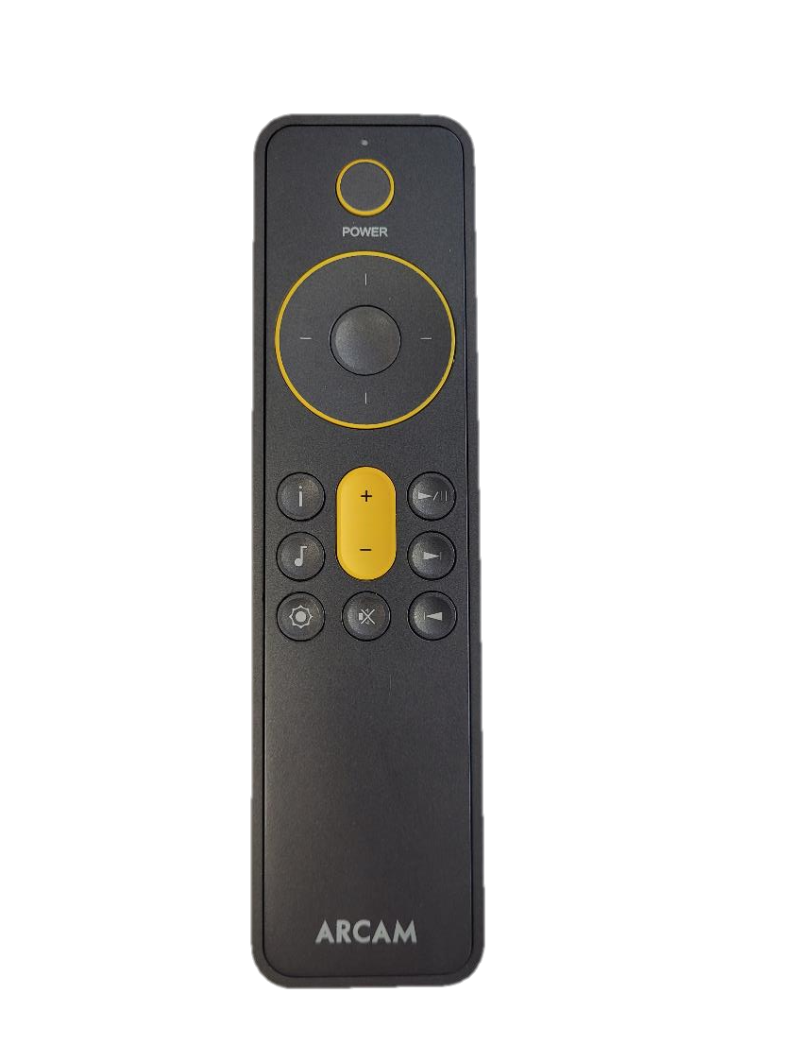
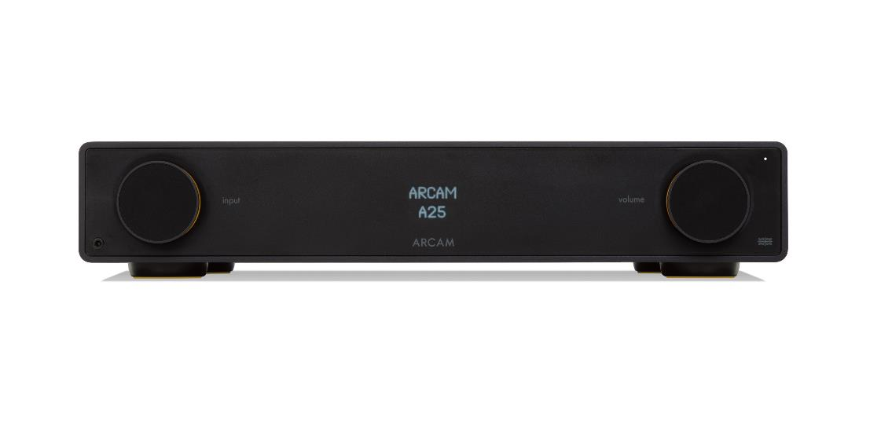
How to select the DAC Filters on ARCAM Radia amplifier
4
3
USE LEFT / RIGHT CURSOR TO SCROLL ACROSS TO SELECT THE DESIRED DAC FILTER
PRESS THE SELECT BUTTON TO CONFIRM THE FILTER
2
USE UP / DOWN CURSOR TO SCROLL DOWN TO THE DAC FILTER OPTION
1
PRESS THE MUSIC MENU BUTTON TO ACCESS THE AUDIO SETTINGS MENU
AUDIO SETTINGS
DAC FILTER
MIN PHASE SLOW
HYBRID FAST
LIN PHASE FAST

