Slide 1
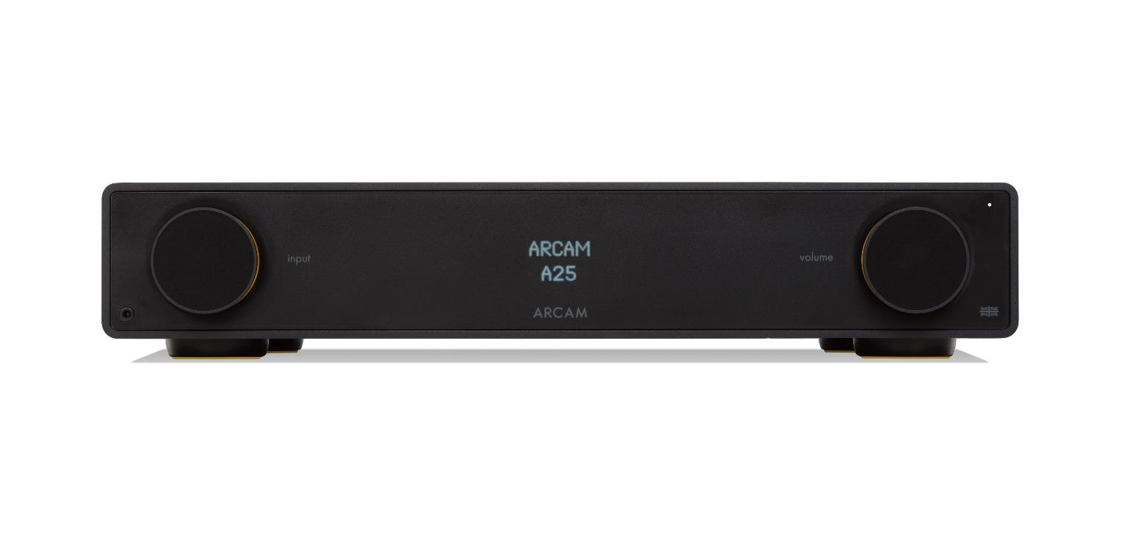
How to switch off the display on your Arcam Radia Amplifier
Press the DISPLAY button on the remote control
The display will show DISPLAY ON and will change to DISPLAY OFF when pressed again.
Press the SELECT button once desired setting is displayed
The display will appear briefly when any button is pressed and then switch off again
STREAMER
DISPLAY OFF
DISPLAY ON

