Slide 1
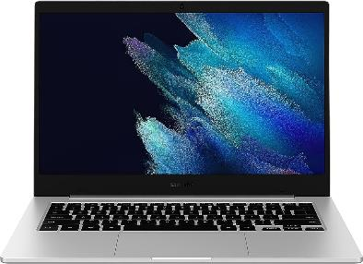
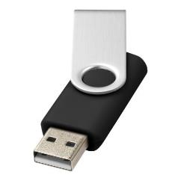
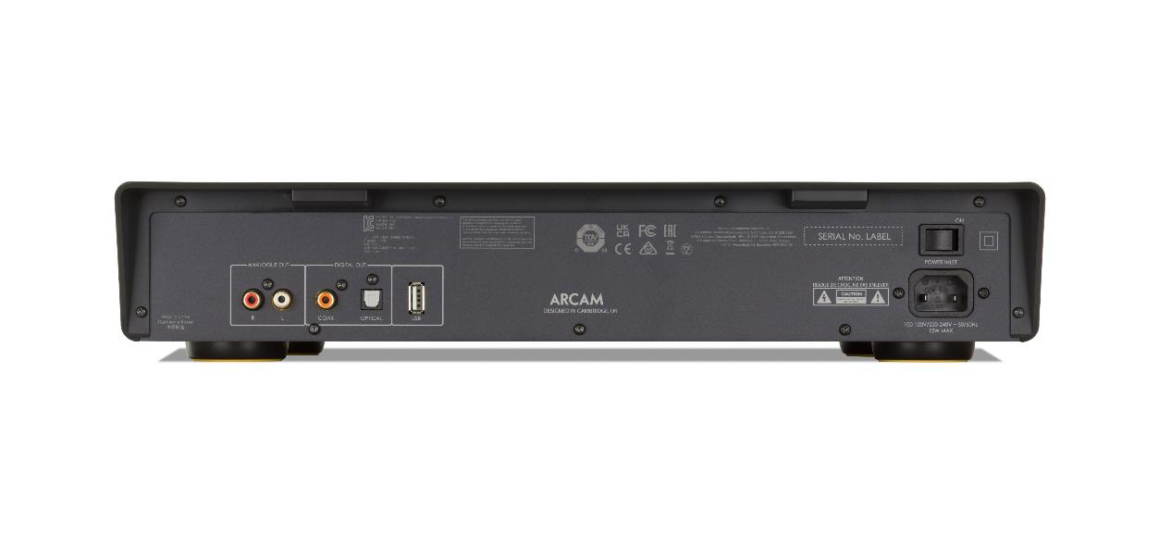
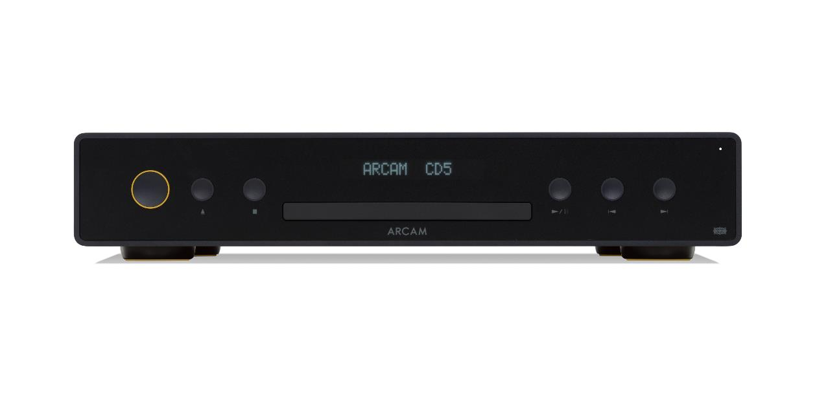
How to update the software on CD5
Unzip and copy the unzipped update files (named updata.cdp and usrcd05.bin) to a USB stick.
Power on the CD player remove any discs from the player and close the drawer.
Plug USB stick into the back of the CD player.
Press and hold both the STOP and PLAY/PAUSE key on the front panel for 5 seconds display will show “CD UPDATING”
Once completed the CD player will show “NO DISC”.
Remove the USB stick.
Step 2
Power off the CD player with the mains switch on the back of the CD player.
While pressing and holding the STANDBY button on the front panel power on the CD player with the mains switch
Release the STANDBY button, POWER LED should not be lit.
Plug USB stick into the back of the CD player.
After a brief pause the POWER LED will light.
Remove the USB stick.
CD UPDATING
NO DISC

