Slide 1
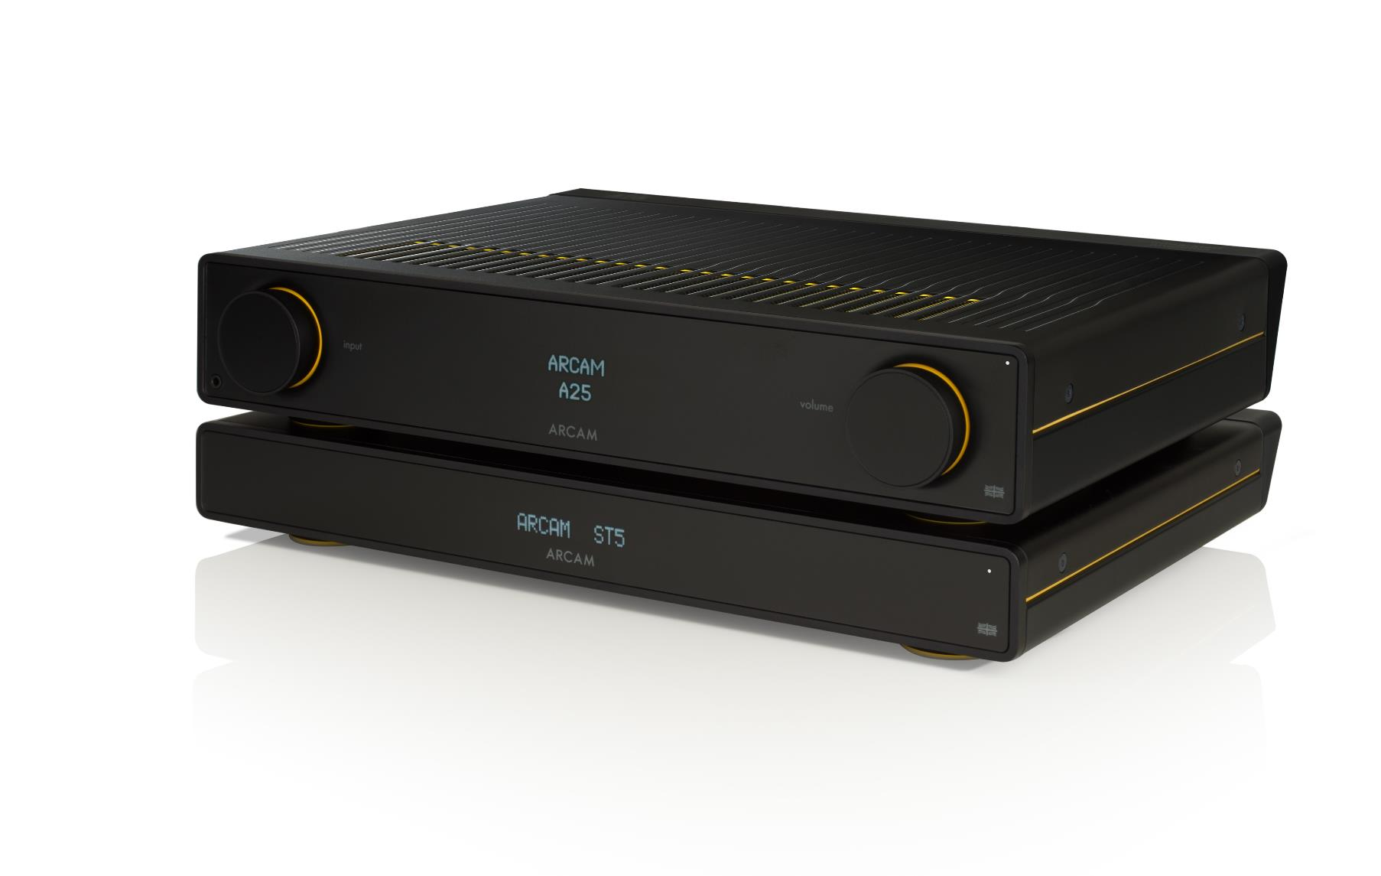
RADIA
How to use the control connection between ARCAM ST5 and ARCAM RADIA Amp

Slide 2
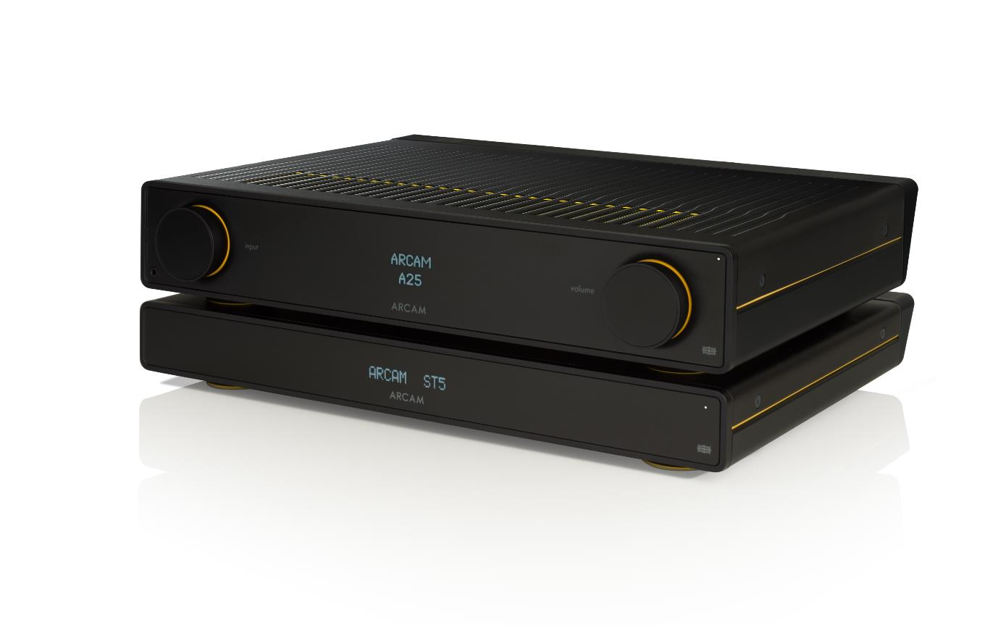
Control & Connectivity
Control Connection for ST5
For customers also purchasing an additional unit such as the new ST5 streamer , the new series of Arcam amplifiers now include a dedicated control connection allowing for easy control of both devices from one remote..
Using the Connect cable supplied with the new ARCAM range of streamers you can control functions such as switching on and volume from the one remote.
If you switch your streamer on , it will automatically switch the amplifier on ad also and select the relevant input ready to play.
Now the 2 units will be working as one rather than 2 separately connected units.

Slide 3
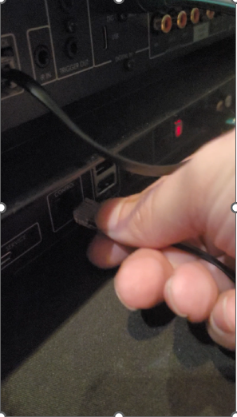
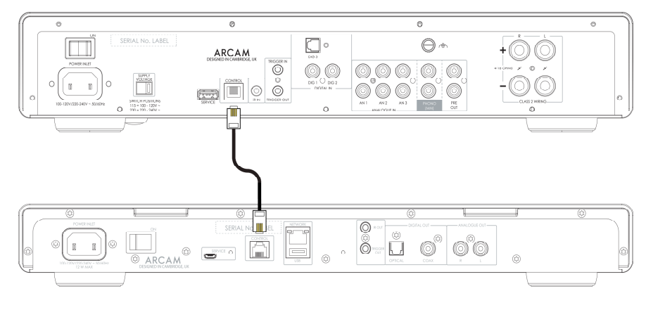
How to use the control connection between ST5 and Amp
Connect the control cable from the ST5 CONTROL socket to the CONTROL socket on the ARCAM amplifier.

Slide 4
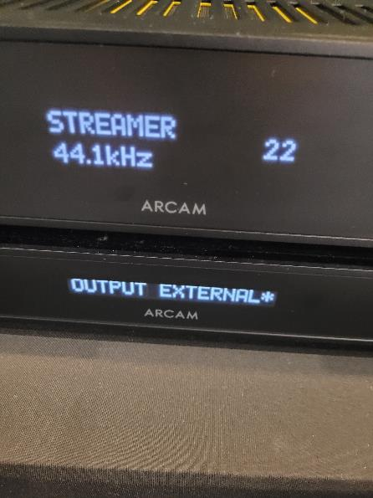
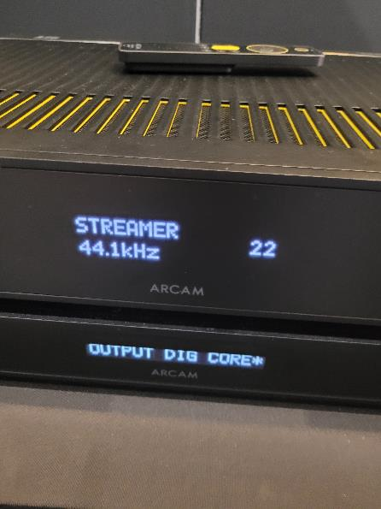
How to use the control connection between ST5 and Amp
In the ST5 settings menu, change the Volume Output option to EXTERNAL.
In the ST5 settings menu, change the Output Type to Analogue or Digital (DIG CORE) to match the audio connection type used.

Slide 5
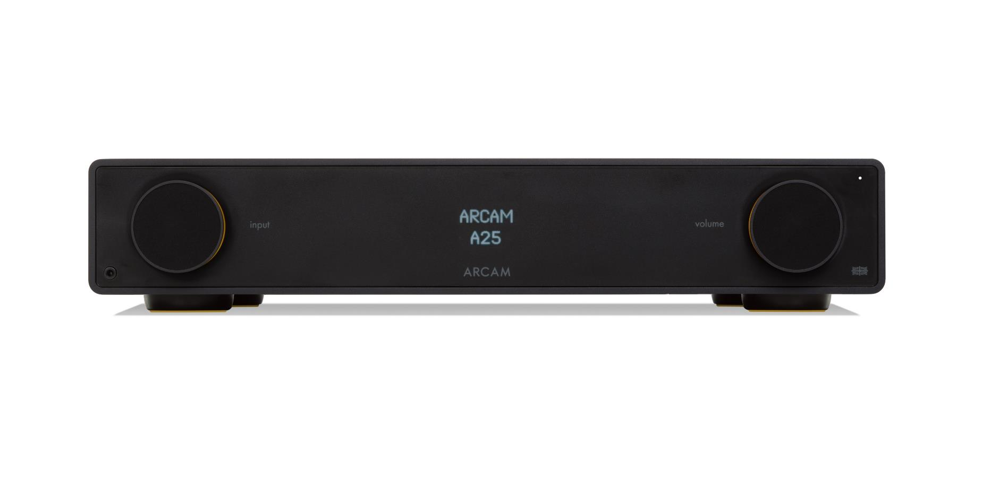
How to use the control connection between ST5 and Amp
In the ARCAM amplifier, change the Streamer Input option in the System Settings menu to match the input that you have connected the ST5 into.
DIG1 = STREAMER
How to change input label

Slide 6
How to change the input name on your ARCAM RADIA amplifier
Select the input you wish to change by turning the input dial and pushing in to select
Press and hold the input button for approx. 3 seconds
Turn dial to select preset input name
Once the desired preset name appears press the input dial in to confirm
The display will now show that name each time the input is selected
ANALOGUE 1
AN1 = CD
AN1 = STREAMER
AN1 = AV
AN1 = TAPE
AN1 = TURNTABLE
AN1 = TV
AN1 = NET
STREAMER
DIG1 = STREAMER
DIG1 = AUX

Slide 7
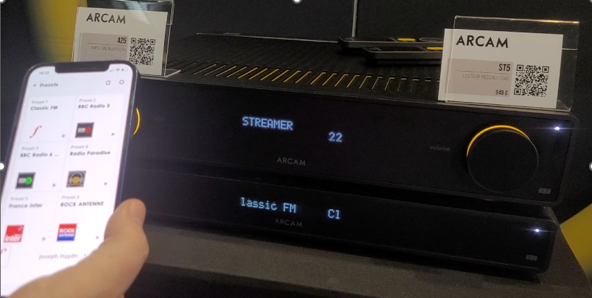
How to use the control connection between ST5 and Amp
The Control connection allows for the ARCAM ST5 to synchronise with, and control an ARCAM Radia series amplifier. When streaming, it allows for the combination of streamer and amplifier to act as one, whilst enjoying the benefits of component devices with separate chassis and power supplies.

